Slide 1

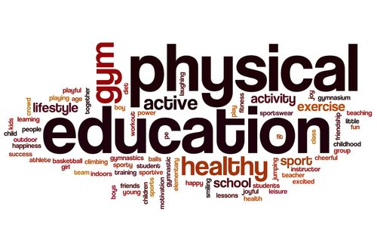

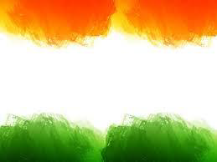
SHRI GURU GOBIND SINGH JI GOVT. COLLEGE,
PAONTA SAHIB, SIRMOUR (H.P)

Slide 2

B.A. 3RD YEAR
COURSE NAME: KINESIOLOGY AND BIOMECHANICS
COURSE CODE: PED306TH

Slide 3
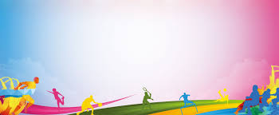
BIOMECHANICS

Slide 4
TOPICS TO BE COVERED
MEANING OF BIOMECHANICS
BENEFITS OF BIOMECHANICS.
BIOMECHANICS TERMS

Slide 5
MEANING OF BIOMECHANICS
Biomechanics is the study of the structure, function and motion of the mechanical aspects of biological systems, at any level from whole organisms to organs, cells and cell organelles, using the methods of mechanics. Biomechanics is a branch of biophysics.

Slide 6
BENEFITS OF BIOMECHANICS.
Basically, understanding biomechanics and applying it is the foundation for good technique in all sports.
So by studying how the human body naturally wants to move we can remove stress and pressure on the bones, joints, muscles and ligaments.
This results in improved athletic performance, reduced injuries and heightened general wellbeing.
Athletes of all ages and skill levels can benefit from biomechanical analysis whether it’s for pain reduction or to increase top level performance.

Slide 7
Here are some more benefits of proper biomechanics:
Increased movement speed (running, swimming, etc.)
More power (jumping, hitting, lifting, etc.)
Energy conservation through economy of movement.
Helps eliminate muscle imbalances.
Reduces wear and tear on joints and ligaments.
Improved sport specific form and technique.
In a nutshell, with good biomechanics you can get faster and stronger while reducing injuries

Slide 8
BIOMECHANICS TERMS
Velocity
Velocity is the directional speed of a object in motion as an indication of its rate of change in position as observed from a particular frame of reference and as measured by a particular standard of time.
Acceleration
Acceleration, rate at which velocity changes with time, in terms of both speed and direction. A point or an object moving in a straight line is accelerated if it speeds up or slows down. Motion on a circle is accelerated even if the speed is constant, because the direction is continually changing.

Slide 9
WHAT IS GRAVITY?
Gravity is a force which tries to pull two objects toward each other.
Anything which has mass also has a gravitational pull. The more massive an object is, the stronger its gravitational pull is.
Earth's gravity is what keeps you on the ground and what causes objects to fall.
Gravity is what holds the planets in orbit around the Sun and what keeps the Moon in orbit around Earth.
The closer you are to an object, the stronger its gravitational pull is. Gravity is what gives you weight. It is the force that pulls on all of the mass in your body.

Slide 10
Friction is the force that opposes the motion of a solid object over another. There are mainly four types of friction: static friction, sliding friction, rolling friction, and fluid friction.
Speed is the time rate at which an object is moving along a path, while velocity is the rate and direction of an object's movement. Put another way, speed is a scalar value, while velocity is a vector.
Work is product of force and displacement of a body along the same line as that force is acting.

Slide 11
There are two forms of mechanical energy: kinetic energy, related to motion of a body, and potential energy, related to the position of a body in the Earth’s gravitational field.
Force is a simple way to represent load in biomechanics and can be defined as the action of one object to another. Force can be external or internal. External forces either pull or push on the body that occurs from sources outside the body.

Slide 12


